Slide 1
Data Analytics
Prediction Error
S.V.Jansi Rani
Assistant Professor / CSE
Notes:
The University of Adelaide, School of Computer Science
Chapter 2 — Instructions: Language of the Computer

Slide 2


Prediction Error
The value of a random variable Y depends on the outcome of a random exp.
Predicting the value of Y before : distr of Y depends on random vector X= (X₁,X₂,…..X_{n})
In linear regression model,
Goal of DA, gain info from training sample
to estimate parameters from the model
Once the model is predicted, use it to make predictions
If Y is numeric, - regression
If Y is discrete - classification

Slide 3
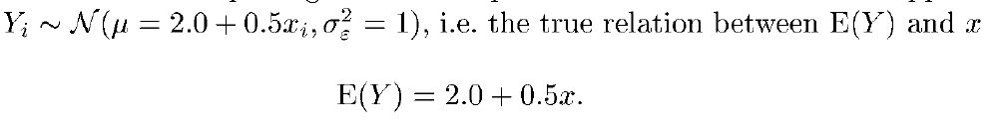
Make assumption in linear regression model
If the true relationship is not linear, then the estimated model will produce prediction error due to unwarranted assumption
Eg:
Sample T of ten (x,y) observations , x is not a r.v.
x=1,2 ..,10
Fig 2.3(a),-> E(Y) is not on straight line due to inherent variablity of Y.

Slide 4
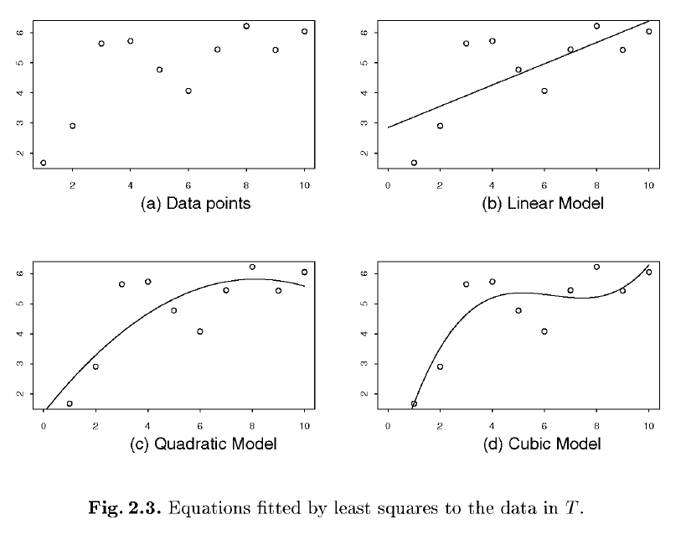

Slide 5
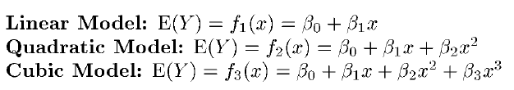
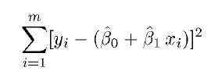
Three models used to describe relation between x and y
Least square estimate
Fig 2.3 b,c,d
Best fit is cubic model for this data
For T’ cubic is worse because of overfitting : cubic model has adjusted itself to the random variations in T, leading on average to bad predictive performance on new samples

Slide 6
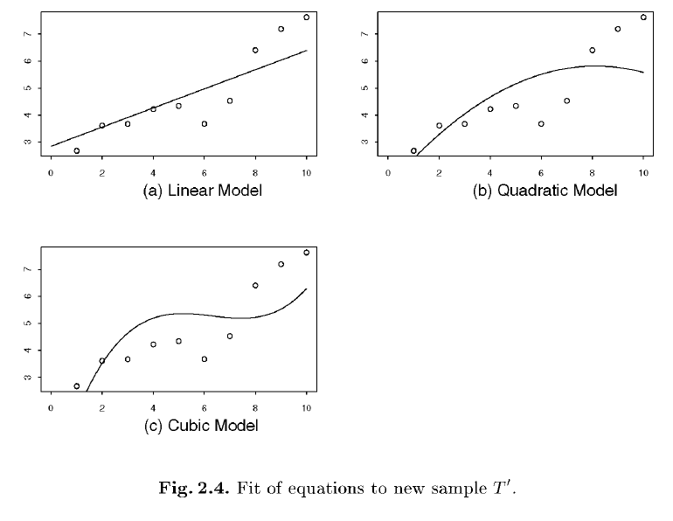

Slide 7



Prediction Error in Regression
After estimating from training set T, use the resulting function to predict y
Quality measure for predicting y is mean squared error.
The difference between prediction and realisation y is called prediction error
Decompose overall error into reducible and irreducible part
The last term is called MSE – irreducible

Slide 8


Concentrate on reducible source of error
Take expectation over all possible training samples and decompose it into bias and variance components
Example
x_{i}=( 1,2 …10)

Slide 9
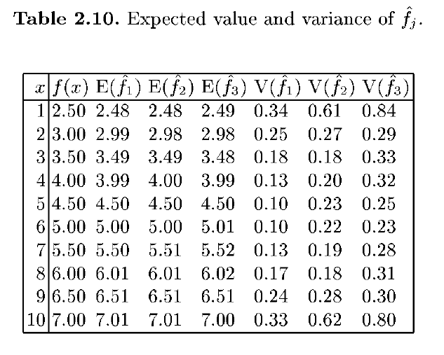

Slide 10
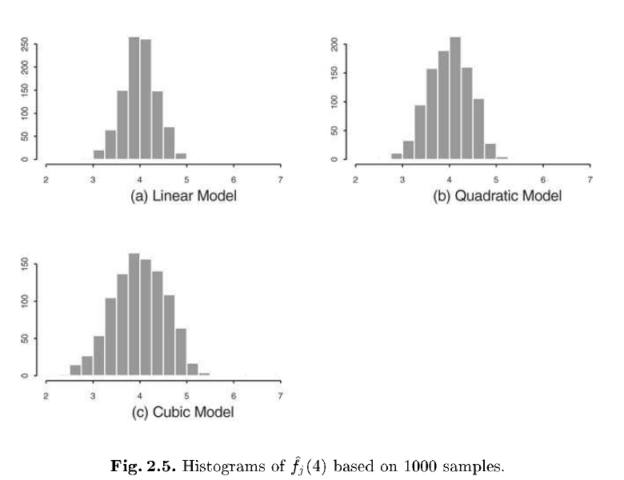
F(4) = E(Y|x=4) = 2+0.5 *4 =4
Linear model has lowest variance

Slide 11
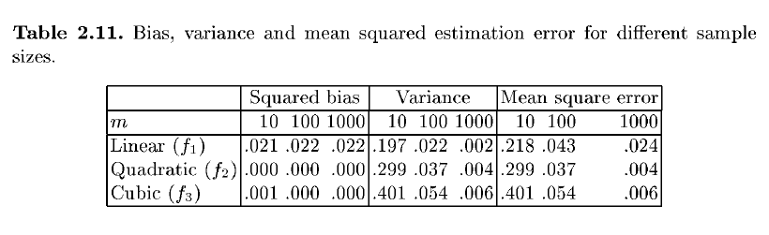
From histogram, linear model has narrow spread – lower prediction error
Incorrect models lead to high bias, but highly flexible models suffer from high variance
For fixed bias, variance tends to decrease when training sample gets larger
For larger training samples, bias tends to be the most important source of prediction error

Slide 12
Thank You

